Slide 1

Test Driven Development With Blazor
Slides up at scottsauber.com
scottsauber

Slide 2

Audience
Familiar with Blazor
Interested in learning TDD
scottsauber

Slide 3
Agenda
What is TDD?
Why TDD?
Tools you can use
What do I test?
Live Demos
scottsauber

Slide 4
Goals
Learn “best practices*” for writing frontend tests
Learn how to TDD with Blazor
* Synonym for “Just My Opinions” and I’ll probably find a way I like better in the future
scottsauber

Slide 5


Who am I?
Director of Engineering at Lean TECHniques
Co-organizer of Iowa .NET User Group
Microsoft MVP
Friend of Redgate
Blog at scottsauber.com
Used React, Blazor, or Angular last 7 years
scottsauber

Slide 6
Why do we write tests?
We want confidence our application works
Minimize manual verification
Document behavior through tests
scottsauber

Slide 7
How to TDD?
Think
Write a test that describes the behavior you want to see
Run the test and watch it fail for the right reason
Write code to make it pass
Refactor
Repeat
scottsauber

Slide 8
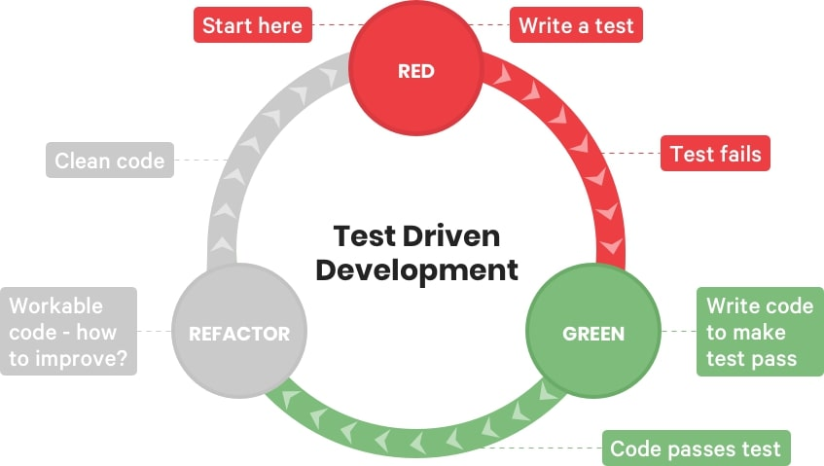
How to TDD?

Slide 9
Why Test Driven Development?
It’s a disciplined way of working
A great way to focus
A great way to get feedback on if your code and design sucks
A great way to facilitate pair programming
Often leads to very little time in the debugger
Oh yeah… and the regression tests are nice too
scottsauber

Slide 10
What is NOT TDD?
TDD is not a synonym for writing tests
TDD is not writing ALL the tests up front
TDD does not mean no bugs ever (just less)
TDD zealots are harmful
scottsauber

Slide 11

Applying TDD to Blazor

Slide 12
Introduction to Tools
xUnit
NSubstitute
FluentAssertions
bUnit
scottsauber

Slide 13
xUnit
Test framework
Used by Microsoft to test .NET
scottsauber

Slide 14
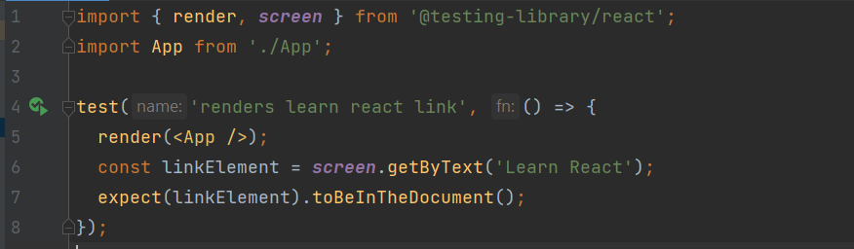
Jest
scottsauber

Slide 15
React Testing Library
@testing-library/react is the package
Utilities for testing React
Encourages behavior-style tests
Encourages avoiding testing implementation details
DOM queries that promote accessibility
Promotes deep rendering
scottsauber

Slide 16
React Testing Library
scottsauber

Slide 17

Demo
Notes:
This is just a hello world create-react-app, so if you run npx create-react-app tdd-demo

Slide 18
What should I test?
Behavior
Not that CSS classes exist or any other attributes directly exist
Behavior
If I can delete code that breaks your app, but your tests don’t – that’s a problem
If my tests break but my application isn’t - that’s a problem
Don’t use snapshots… (mostly)
Snapshots don’t capture desired behavior
Too many implementation details (i.e. classes, DOM nodes, etc.)
Only use snapshots when doing a total refactor but output should be the same
Then delete the test
scottsauber

Slide 19

“The more your tests resemble the way your software is used the more confidence they can give you.”
Kent C Dodds
react-testing-library creator
Notes:
This is just a hello world create-react-app, so if you run npx create-react-app tdd-demo

Slide 20
How do I structure tests?
Avoid lots of describes
Avoid lots of beforeEach nested in describes
Avoid a top-level describe for the component you’re testing
You already know ^ by the file you’re in
Put tests next to the file they’re testing
High cohesion
scottsauber

Slide 21
Live Coding!
Notes:
This is just a hello world create-react-app, so if you run npx create-react-app tdd-demo

Slide 22
How can I get started with TDD?
When you get a bug report coming in
Write a failing test that proves the bug exists
Make it pass
scottsauber

Slide 23

But I don’t have time!

Slide 24

Why?
Notes:
Too understaffed
Too much support work fixing bugs

Slide 25

My boss won’t let me!

Slide 26

What about this person?
Notes:
What if you went to your surgeon and said “Hey I need this operation done” and he goes “Okay it’ll take 24 hours.” And if you respond “Okay but can you do it in 4?” …would you want to get surgery from the surgeon who agrees to that?
“Oh yeah I can totally do that surgery in 4 hours, I just need to not wash my hands, not wash the tools from the last surgery, and I’ll just use 5 stitches to sew you up instead of 50.”

Slide 27
You don’t get better at TDD by NOT doing TDD

Slide 28
Takeaways
Why you should TDD
How to test React
What to test in React
How to get started TDDing React
scottsauber

Slide 29

Resources
TDD By Example by Kent Beck
Write Tests blog post by Kent C Dodds
https://github.com/scottsauber/talks
This slide deck
scottsauber

Slide 30
Questions?
Slides up at scottsauber.com
scottsauber

Slide 31
Thanks!
Slides up at scottsauber.com
scottsauber

